Slide 1


Windows Server 2019
By Brian Kilburn and Aaron Voynar

Slide 2
Hybrid Integration
What is Hybrid Integration?
Combination of Admin Center with Azure Extensions

Slide 3
Hybrid Integration
What is Hybrid Integration?
Combination of Admin Center with Azure Extensions
Storage Migration Service

Slide 4
Hybrid Integration
What is Hybrid Integration?
Combination of Admin Center with Azure Extensions
Storage Migration Service
File Sync with Azure

Slide 5
Hybrid Integration
What is Hybrid Integration?
Combination of Admin Center with Azure Extensions
Storage Migration Service
File Sync with Azure
Storage Replica

Slide 6
AZURE SERVICES
SaaS (Software as a Service)

Slide 7
AZURE SERVICES
SaaS (Software as a Service)
PaaS (Platform as a Service)

Slide 8
AZURE SERVICES
SaaS (Software as a Service)
PaaS (Platform as a Service)
IaaS (Infrastructure as a Service)

Slide 9
Storage Migration Features
Transfer of Data from legacy systems to WS2019

Slide 10
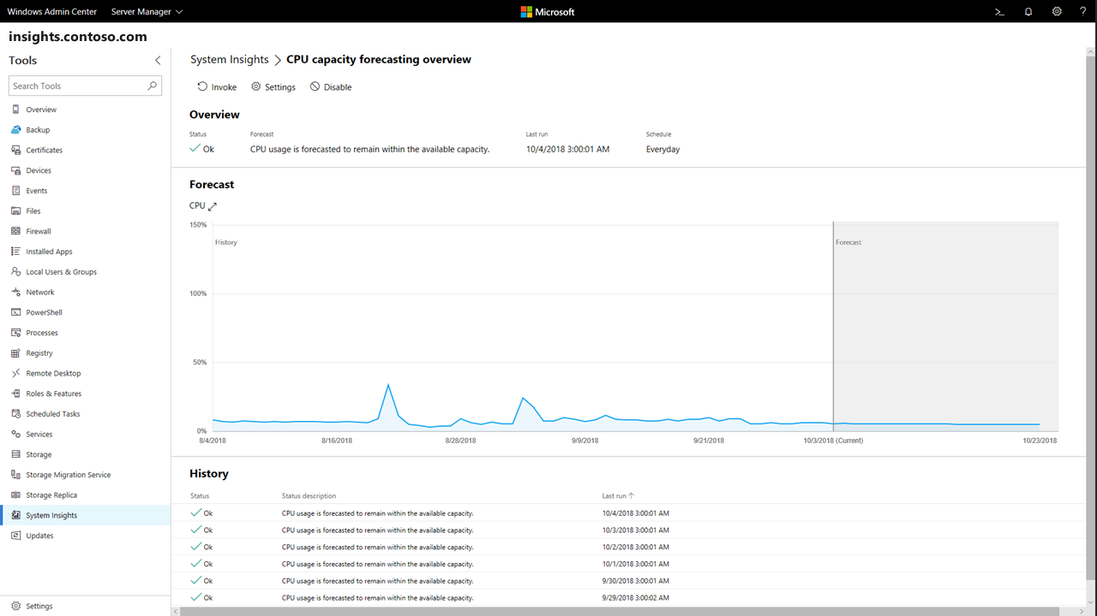
System Insights

Slide 11
Storage Migration Features
Transfer of Data from legacy systems to WS2019
easy setup of a point-to-point VPN to the Azure services

Slide 12
https://www.youtube.com/watch?v=3wvTYbnXyB4

